Slide 1
Application Delivery Fundamentals 2.0 B: Java
Spring Security

Slide 2
Goals
User credentials are sent in clear / easy to decode format
Apply Salted Hash technique on the password.
Session Fixation
Follow a secure session management lifecycle which includes proper initialization, maintenance, authentication and termination of the session token.
Host Header Attack
The web application should use the SERVER_NAME instead of the Host header.

Slide 3
Goals
HTML Injection
Implement validations to escape all html tags and special characters from the user supplied input.
Reflective Cross Site Scripting
The best way to prevent cross-site scripting is to make sure that the web application does not make use of user input in the subsequent HTML pages, without validating or sanitizing it .

Slide 4
Goals
Authorization Bypass
Maintain proper authorization schema.
Improper error handling
Create a default error handler which returns an appropriately sanitized error message for most users in production for all error paths.
Vulnerable Remember Password
Ensure that no credentials are stored in clear text or are easily retrievable in encoded or encrypted forms in cookies.

Slide 5
Goals
Vulnerable Javascript library
Missing Security Headers
Session Hijacking
Unused Ports/Services
LUCKY13
Possible Bruteforce Attack
HTML / iFrame Injection

Slide 6
User credentials are sent in clear / easy to decode format
Password Hashing
Hash algorithms are one way functions. They turn any amount of data into a fixed-length "fingerprint" that cannot be reversed.
They also have the property that if the input changes by even a tiny bit, the resulting hash is completely different.
This is great for protecting passwords, because we want to store passwords in a form that protects them even if the password file itself is compromised.
But at the same time, we need to be able to verify that a user's password is correct.

Slide 7
User credentials are sent in clear / easy to decode format
The general workflow for account registration and authentication in a hash-based account system is as follows:
The user creates an account.
Their password is hashed and stored in the database. At no point is the plain-text (unencrypted) password ever written to the hard drive.
When the user attempts to login, the hash of the password they entered is checked against the hash of their real password (retrieved from the database).
If the hashes match, the user is granted access. If not, the user is told they entered invalid login credentials.
Steps 3 and 4 repeat every time someone tries to login to their account.
In step 4, never tell the user if it was the username or password they got wrong. Always display a generic message like "Invalid username or password." This prevents attackers from enumerating valid usernames without knowing their passwords.

Slide 8
User credentials are sent in clear / easy to decode format
The hash functions used to implement data structures such as hash tables are designed to be fast, not secure.
Only cryptographic hash functions may be used to implement password hashing.
Hash functions like SHA256, SHA512, RipeMD, and WHIRLPOOL are cryptographic hash functions.

Slide 9
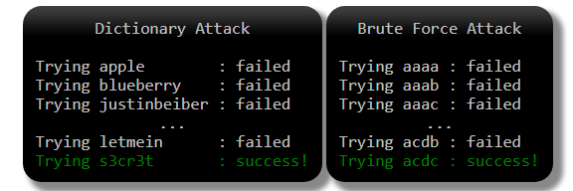
User credentials are sent in clear / easy to decode format
How Hashes are Cracked
Dictionary and Brute Force Attacks

Slide 10
User credentials are sent in clear / easy to decode format
How Hashes are Cracked
Lookup Tables
Lookup tables are an extremely effective method for cracking many hashes of the same type very quickly.
The general idea is to pre-compute the hashes of the passwords in a password dictionary and store them, and their corresponding password, in a lookup table data structure.
A good implementation of a lookup table can process hundreds of hash lookups per second, even when they contain many billions of hashes.

Slide 11
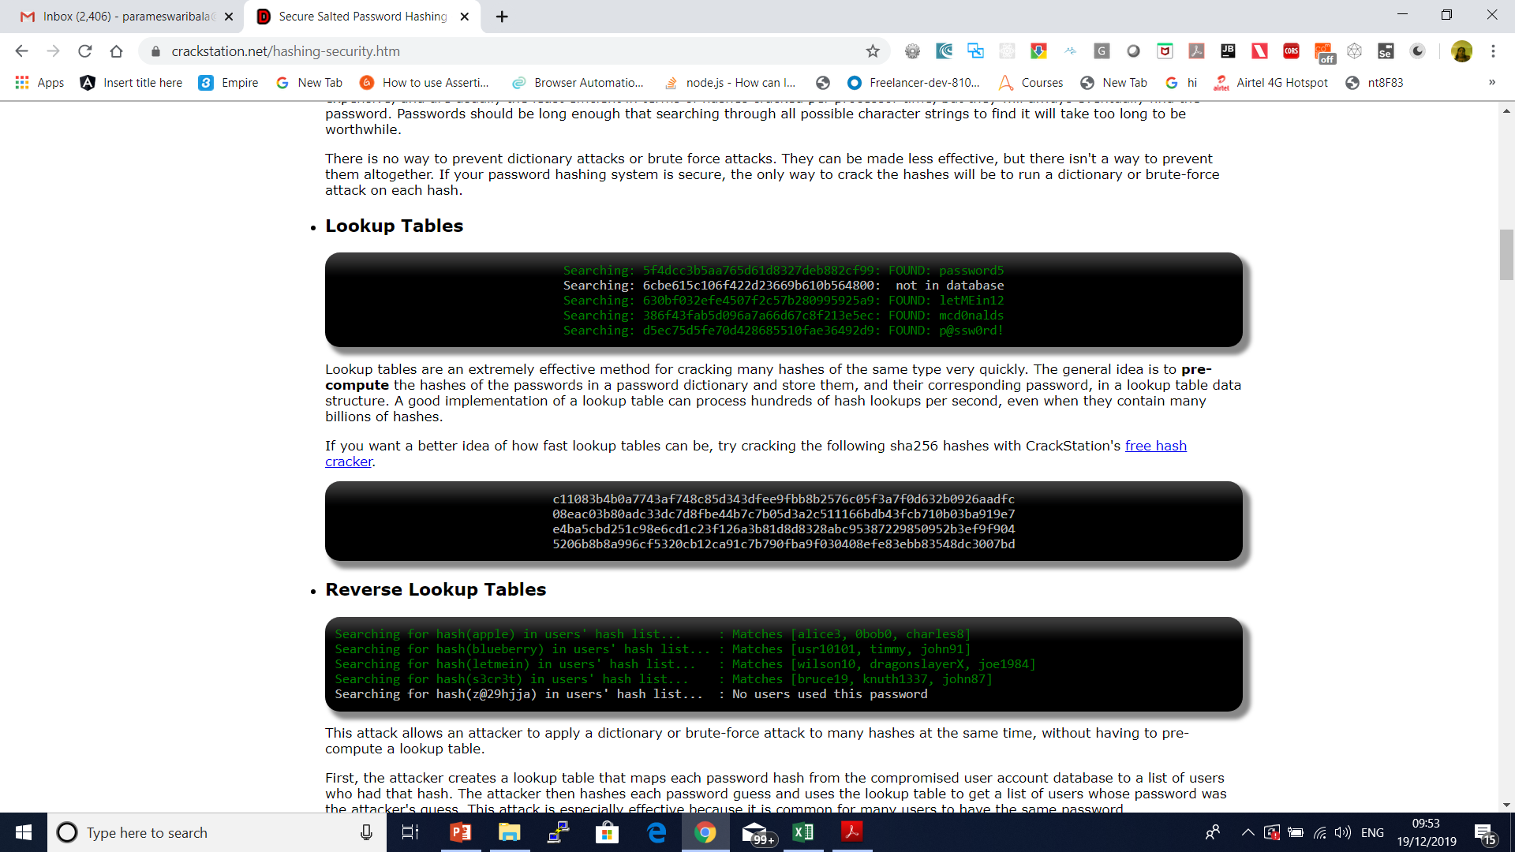
User credentials are sent in clear / easy to decode format
How Hashes are Cracked
Lookup Tables

Slide 12
User credentials are sent in clear / easy to decode format
How Hashes are Cracked
The WRONG Way: Short Salt & Salt Reuse
Salt Reuse
A common mistake is to use the same salt in each hash.
Either the salt is hard-coded into the program, or is generated randomly once.
This is ineffective because if two users have the same password, they'll still have the same hash.
An attacker can still use a reverse lookup table attack to run a dictionary attack on every hash at the same time.
They just have to apply the salt to each password guess before they hash it.
If the salt is hard-coded into a popular product, lookup tables and rainbow tables can be built for that salt, to make it easier to crack hashes generated by the product.

Slide 13
User credentials are sent in clear / easy to decode format
Short Salt
If the salt is too short, an attacker can build a lookup table for every possible salt. For example, if the salt is only three ASCII characters, there are only 95x95x95 = 857,375 possible salts.
That may seem like a lot, but if each lookup table contains only 1MB of the most common passwords, collectively they will be only 837GB, which is not a lot considering 1000GB hard drives can be bought for under $100 today.
For the same reason, the username shouldn't be used as a salt.
Usernames may be unique to a single service, but they are predictable and often reused for accounts on other services.
An attacker can build lookup tables for common usernames and use them to crack username-salted hashes.
To make it impossible for an attacker to create a lookup table for every possible salt, the salt must be long.
A good rule of thumb is to use a salt that is the same size as the output of the hash function. For example, the output of SHA256 is 256 bits (32 bytes), so the salt should be at least 32 random bytes.

Slide 14
User credentials are sent in clear / easy to decode format
The WRONG Way: Double Hashing & Wacky Hash Functions
Here are some examples of poor wacky hash functions I've seen suggested in forums on the internet.
md5(sha1(password))
md5(md5(salt) + md5(password))
sha1(sha1(password))
sha1(str_rot13(password + salt))
md5(sha1(md5(md5(password) + sha1(password)) + md5(password)))
Do not use any of these.

Slide 15
User credentials are sent in clear / easy to decode format
The RIGHT Way: How to Hash Properly
Salt should be generated using a Cryptographically Secure Pseudo-Random Number Generator (CSPRNG).
CSPRNGs are very different than ordinary pseudo-random number generators, like the "C" language's rand() function.
As the name suggests, CSPRNGs are designed to be cryptographically secure, meaning they provide a high level of randomness and are completely unpredictable.
We don't want our salts to be predictable, so we must use a CSPRNG.

Slide 16
User credentials are sent in clear / easy to decode format
java.lang.Object
extended by java.util.Random
extended by java.security.SecureRandom
SecureRandom random = new SecureRandom();
byte bytes[] = new byte[20];
random.nextBytes(bytes);

Slide 17
User credentials are sent in clear / easy to decode format
To Store a Password
Generate a long random salt using a CSPRNG.
Prepend the salt to the password and hash it with a standard password hashing function like Argon2, bcrypt, scrypt, or PBKDF2.
Save both the salt and the hash in the user's database record.
To Validate a Password
Retrieve the user's salt and hash from the database.
Prepend the salt to the given password and hash it using the same hash function.
Compare the hash of the given password with the hash from the database. If they match, the password is correct. Otherwise, the password is incorrect.

Slide 18
User credentials are sent in clear / easy to decode format
Making Password Cracking Harder: Slow Hash Functions
Use a standard algorithm like PBKDF2 or bcrypt.

Slide 19
User credentials are sent in clear / easy to decode format
Hashing Passwords in Java with Bcrypt.
BCrypt is a one way salted hash function based on the Blowfish cipher.
It provides several enhancements over plain text passwords.

Slide 20
User credentials are sent in clear / easy to decode format
BCrypt features
Not plain text - Not only do plain text passwords compromise your website if the database is breached but they can also compromise other websites for the users. Unfortunately a lot of users share passwords across websites.
One way hashing - BCrypt is a one way hash function to obfuscate the password such that it is not stored in plain text.
Salted hashing - Generating random bytes (the salt) and combining it with the password before hashing creates unique hashes across each users password. If two users have the same password they will not have the same password hash. This is to prevent rainbow table attacks which can reverse hashed passwords using common hashing functions that do not utilize a salt.
Logarithmic iterations - The hashing function is executed many times sequentially which can be increased exponentially known as key stretching. This is to make the function CPU intensive which makes it more secure against brute force attacks.
Updatable iterations - As CPUs become faster so do brute force attacks. Since BCrypt stores the number of iterations as part of the hash it's possible to verify a password and then increase its strength by generating a new hash with a higher number of iterations.

Slide 21
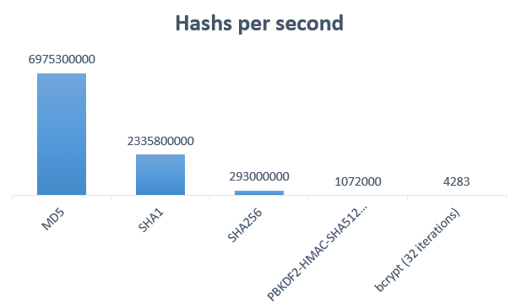

Slide 22
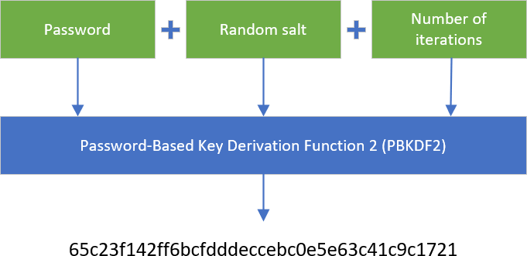

Slide 23
Host Header Attack
The “HOST” header is part of the http protocol, vulnerable applications are vulnerable because they insert the value of this header into the application code without proper validation.
It means not only applications hosted on Apache/Nginx can be vulnerable.
For Host Header Attack Exploitation, basically there are two ways through which you can exploit the application i.e.
By means of Web Cache Poisoning which manipulates caching systems into storing a page generated with a malicious host .
other is via Password Reset Emails when poisoned content is delivered directly to the target.

Slide 24
Why HTTP host header needed ?
According to RFC 2616: A client MUST include a Host header field in all HTTP/1.1 request messages.
If the requested URI does not include an Internet host name for the service being requested, then the Host header field MUST be given with an empty value.
Any HTTP/1.1 request without host header field must be responded by server with 400(bad request) status code.

Slide 25
Why HTTP host header needed ?
There are several different types of attacks related to host header injection
Unauthorized URL Redirect by Cache poisoning
Password Reset Poisoning
Access to internal hosts
Cross site scripting

Slide 26
Why HTTP host header needed ?
There are several different types of attacks related to host header injection
Unauthorized URL Redirect by Cache poisoning
Password Reset Poisoning
Access to internal hosts
Cross site scripting

Slide 27
Prevent Host Header Attack
<a href="<?=$_SERVER['HTTP_HOST']?>/blog/">Blog</a>

Slide 28
HTML Injection
The essence of this type of injection attack is injecting HTML code through the vulnerable parts of the website.
The Malicious user sends HTML code through any vulnerable field with a purpose to change the website’s design or any information, that is displayed to the user.
In the result, the user may see the data, that was sent by the malicious user.
Therefore, in general, HTML Injection is just the injection of markup language code to the document of the page.
Data, that is being sent during this type of injection attack may be very different.
It can be a few HTML tags, that will just display the sent information. Also, it can be the whole fake form or page.
When this attack occurs, the browser usually interprets malicious user data as legit and displays it.

Slide 29
Types of HTML Injection
Firstly, different types may be sorted by the risks, that they bring.
As mentioned, this injection attack can be performed with two different purposes:
To change the displayed website’s appearance.
To steal another person’s identity.
However, the main types are:
Stored HTML Injection
Reflected HTML Injection

Slide 30
Stored HTML Injection:
Stored injection attack occurs when malicious HTML code is saved in the web server and is being executed every time when the user calls an appropriate functionality.

Slide 31
Reflected HTML Injection:
This can be again divided into more types:
Reflected GET
Reflected POST
Reflected URL

Slide 32
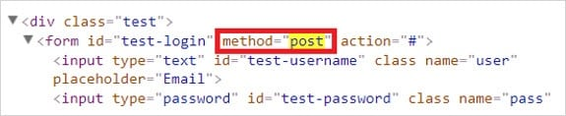
For Example, a tester can check the source code for the login form and find what method is being used for it. Then appropriate HTML Injection method can be selected accor

Slide 33
Reflected HTML Injection:
Reflected GET Injection occurs, when our input is being displayed (reflected) on the website.
Suppose, we have a simple page with a search form, which is vulnerable to this attack.
Then if we would type any HTML code, it will appear on our website and at the same time, it will be injected into the HTML document.

Slide 34
How to Prevent HTML Injection?
There are no doubts, that the main reason for this attack is the developer's inattention and lack of knowledge.
This type of injection attack occurs when the input and output are not properly validated.
Therefore the main rule to prevent HTML attack is appropriate data validation.

Slide 35
Authentication Bypass
Applications require authentication for gaining access to private information.
Not every authentication method is able to provide adequate security.
A flaw in the application that allows users to access application resources without authentication is referred as’ Authentication Bypass’.
Authentication bypass vulnerability is generally caused when it is assumed that users will behave in a certain way and failing to foresee the consequences of users doing the unexpected.

Slide 36
Methods to bypass the authentication schema:
There are several methods to bypass the authentication schema in use by a web application. Here are some of the common ways to bypass authentication:
Direct page request (Forced Browsing)
Parameter Modification
Session ID Prediction
SQL Injection

Slide 37
Test Authorization Bypass
Testing for access to administrative functions
For example, suppose that the 'AddUser.jsp' function is part of the administrative menu of the application, and it is possible to access it by requesting the following URL:
https://www.example.com/admin/addUser.jsp

Slide 38
Test Authorization Bypass
Then, the following HTTP request is generated when calling the AddUser function:
POST /admin/addUser.jsp HTTP/1.1
Host: www.example.com
[other HTTP headers]
userID=fakeuser&role=3&group=grp001
What happens if a non-administrative user tries to execute that request? Will the user be created? If so, can the new user use their privileges?

Slide 39
Session Hijacking
TCP session hijacking is a security attack on a user session over a protected network.
The most common method of session hijacking is called IP spoofing, when an attacker uses source-routed IP packets to insert commands into an active communication between two nodes on a network and disguising itself as one of the authenticated users.
This type of attack is possible because authentication typically is only done at the start of a TCP session.

Slide 40
Session Hijacking
Another type of session hijacking is known as a man-in-the-middle attack, where the attacker, using a sniffer, can observe the communication between devices and collect the data that is transmitted.

Slide 41
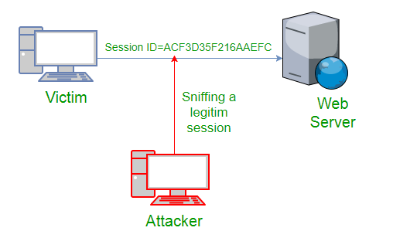
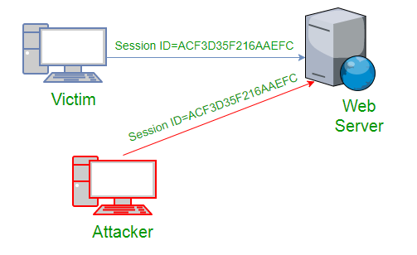

Slide 42
Session Hijacking
Cross Site Scripting(XSS Attack)
Attacker can also capture victim’s Session ID using XSS attack by using javascript.
If an attacker sends a crafted link to the victim with the malicious JavaScript, when the victim clicks on the link, the JavaScript will run and complete the instructions made by the attacker.

Slide 43
Session Hijacking
IP Spoofing
Spoofing is pretending to be someone else.
This is a technique used to gain unauthorized access to the computer with an IP address of a trusted host.
In implementing this technique, attcker has to obtain the IP address of the client and inject his own packets spoofed with the IP address of client into the TCP session, so as to fool the server that it is communicating with the victim i.e. the original host.

Slide 44
Session Hijacking
Blind Attack
If attacker is not able to sniff packets and guess the correct sequence number expected by server, brute force combinations of sequence number can be tried.

Slide 45
Mitigation
To defend a network with session hijacking, a defender has to implement both security measures at Application level and Network level.
Network level hijacks can be prevented by Ciphering the packets so that the hijacker cannot decipher the packet headers, to obtain any information which will aid in spoofing.
This encryption can be provided by using protocols such as IPSEC, SSL, SSH etc.
Internet security protocol (IPSEC) has the ability to encrypt the packet on some shared key between the two parties involved in communication. IPsec runs in two modes: Transport and Tunnel.
In Transport Mode only the data sent in the packet is encrypted while in Tunnel Mode both packet headers and data are encrypted, so it is more restrictive.

Slide 46
Iframe Injection
A Frame Injection is a type of Code Injection vulnerability classified by OWASP Top 10 2017 in its A1 Injection category.
Cross-site Scripting is naturally prioritized by bug bounty hunters since it seems easily exploitable and effective.
But malicious hackers are also attracted to this vulnerability, because there are aspects of the Frame Injection attack that can allow hackers to redirect users to other malicious websites used for phishing and similar attacks.

Slide 47
Iframe Injection
1. First of all attacker will find the Vulnerable websites using google dorks.
2. They test the vulnerability by inserting some iframe tag using the url.
3. then insert the Malicious Iframe code inside the webpage.
For Example:
he can insert this code using the url:
<iframe src=”http://malwarewebpages/web.html” width=1 height=1 style=”visibility:hidden;position:absolute”></iframe>

Slide 48
IFrame Injection Mitigation
Change your passwords of ftp, control panel and database.
Inform to your hosting service about the injection attack and they will take care of server injection .
Download all your files from the hosting and check whether they are infected or not. if you found any infected files, clean it.
Buy a good antivirus software, Scan your Computer completely.
Don’t use the Public systems for logging into your Hosting service.

Slide 49
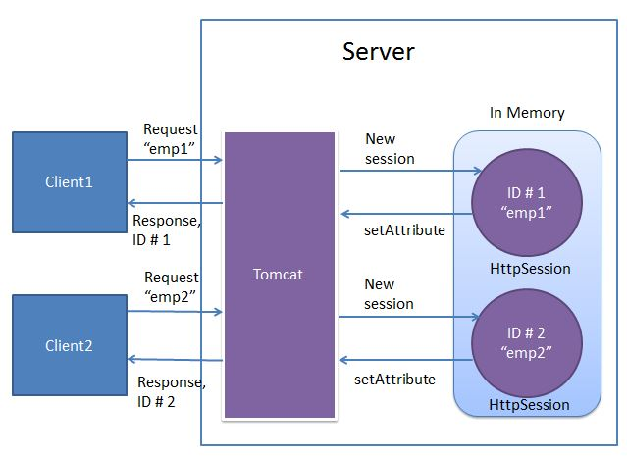

Slide 50
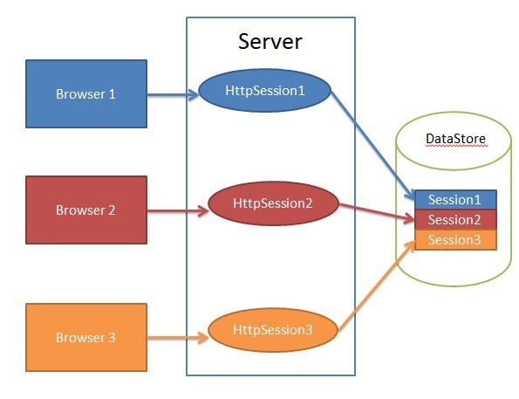

Slide 51
Spring Security
JAAS
SSL
Certificate Handling

Slide 52
Spring Security
Spring framework has two major applications which are authentication and authorization.
Authentication is a process of identifying and knowing the target user which wants to access the application.
Authorization is a process of allowing the authority to perform some actions in the application.
Apply authorization to a web request, methods and access to an individual domain.

Slide 53
Spring Security Integration
Spring Security supports integration with all of these technologies.
HTTP BASIC authentication headers
HTTP Digest authentication headers
HTTP X.509 client certificate exchange
LDAP (Lighweight Directory Access Protocol)
Form-based authentication
OpenID authentication

Slide 54
Spring Security Integration
Automatic remember-me authentication
Kerberos
JOSSO (Java Open Source Single Sign-On)
AppFuse
AndroMDA
Mule ESB
DWR(Direct Web Request)

Slide 55
Advantages of Spring Security
Configuration support to Java Programming Language.
Portable.
Comprehensive support to tasks like authorization and authentication.
Servlet API integration.
Spring MVC integration.
CSRF protection.
Protection against some common tasks.

Slide 56
Spring Security Features
LDAP (Lightweight Directory Access Protocol)
Single sign-on
JAAS (Java Authentication and Authorization Service) LoginModule
Basic Access Authentication
Digest Access Authentication
Remember-me

Slide 57
Spring Security Features
Web Form Authentication
Authorization
Software Localization
HTTP Authorization

Slide 58
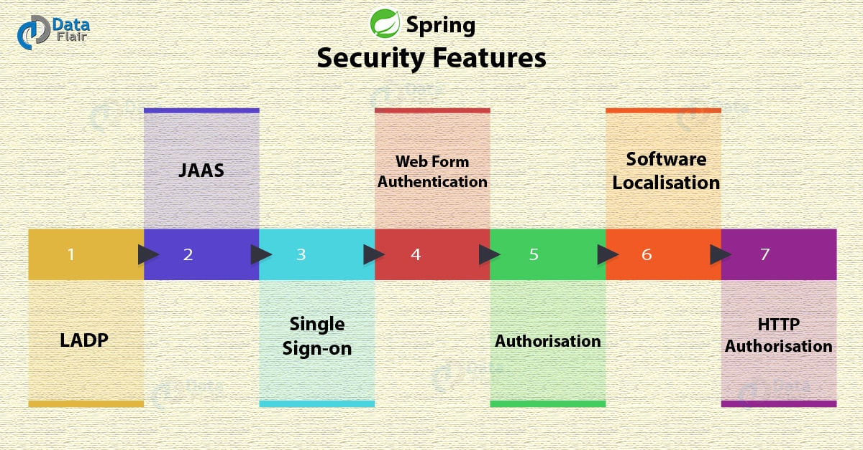
Spring Security Features

Slide 59
Spring Security Features
LDAP (Lightweight Directory Access Protocol)
It is an open application protocol for maintaining and accessing distributed directory information services over an Internet Protocol.
Single sign-on
This feature allows a user to access multiple applications with the help of single account(user name and password).
JAAS (Java Authentication and Authorization Service) LoginModule
It is a Pluggable Authentication Module implemented in Java. Spring Security supports it for its authentication process.

Slide 60
Spring Security Features
Basic Access Authentication
Spring Security supports Basic Access Authentication that is used to provide user name and password while making request over the network.
Digest Access Authentication
This feature allows us to make authentication process more secure than Basic Access Authentication. It asks to the browser to confirm the identity of the user before sending sensitive data over the network.
Remember-me
Spring Security supports this feature with the help of HTTP Cookies. It remember to the user and avoid login again from the same machine until the user logout.

Slide 61
Spring Security Features
Web Form Authentication
In this process, web form collect and authenticate user credentials from the web browser. Spring Security supports it while we want to implement web form authentication.
Authorization
Spring Security provides the this feature to authorize the user before accessing resources. It allows developers to define access policies against the resources.
Software Localization
This feature allows us to make application user interface in any language.

Slide 62
Spring Security Features
HTTP Authorization
Spring provides this feature for HTTP authorization of web request URLs using Apache Ant paths or regular expressions.

Slide 63
Features added in Spring Security 5.0
OAuth 2.0 Login
This feature provides the facility to the user to login into the application by using their existing account at GitHub or Google.
This feature is implemented by using the Authorization Code Grant that is specified in the OAuth 2.0 Authorization Framework.
Reactive Support
From version Spring Security 5.0, it provides reactive programming and reactive web runtime support and even, we can integrate with Spring WebFlux.

Slide 64
Features added in Spring Security 5.0
Modernized Password Encoding
Spring Security 5.0 introduced new Password encoder DelegatingPasswordEncoder which is more modernize and solve all the problems of previous encoder NoOpPasswordEncoder.

Slide 65
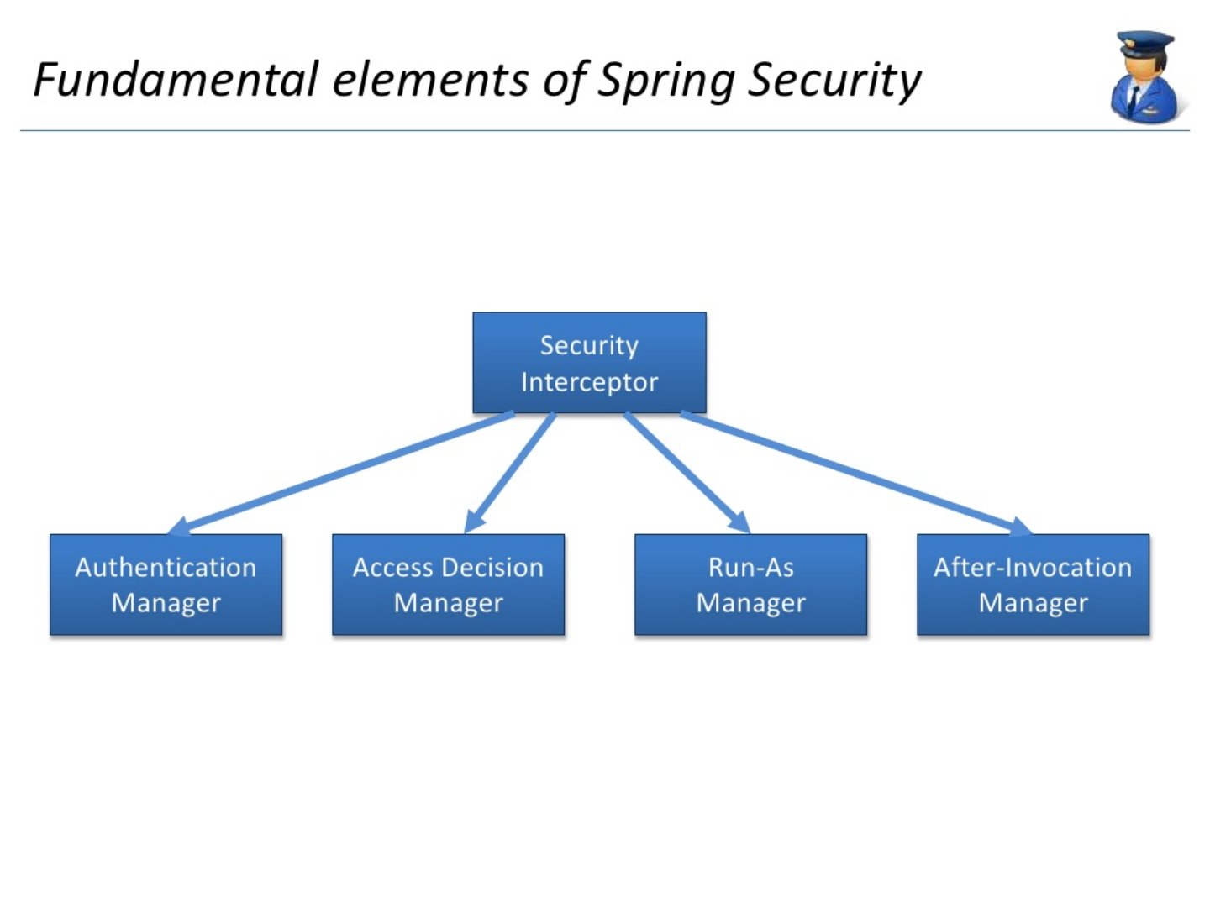

Slide 66
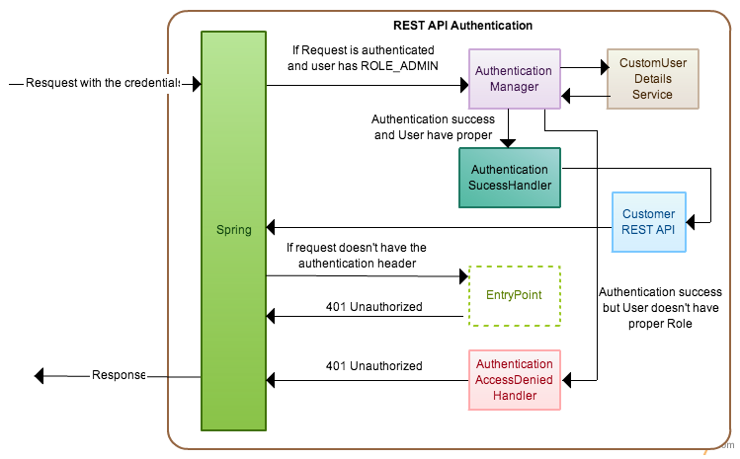

Slide 67
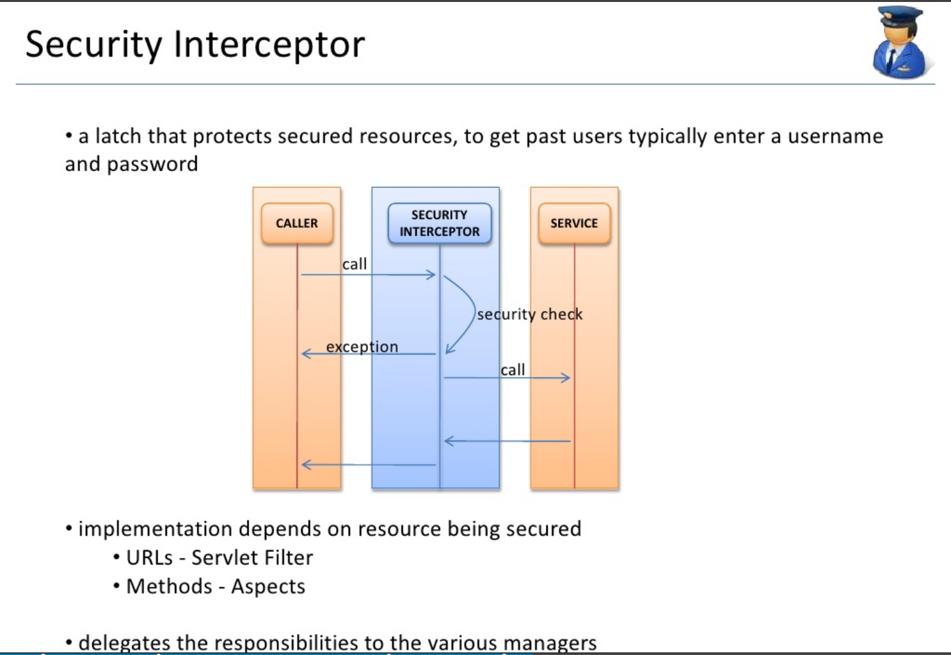

Slide 68
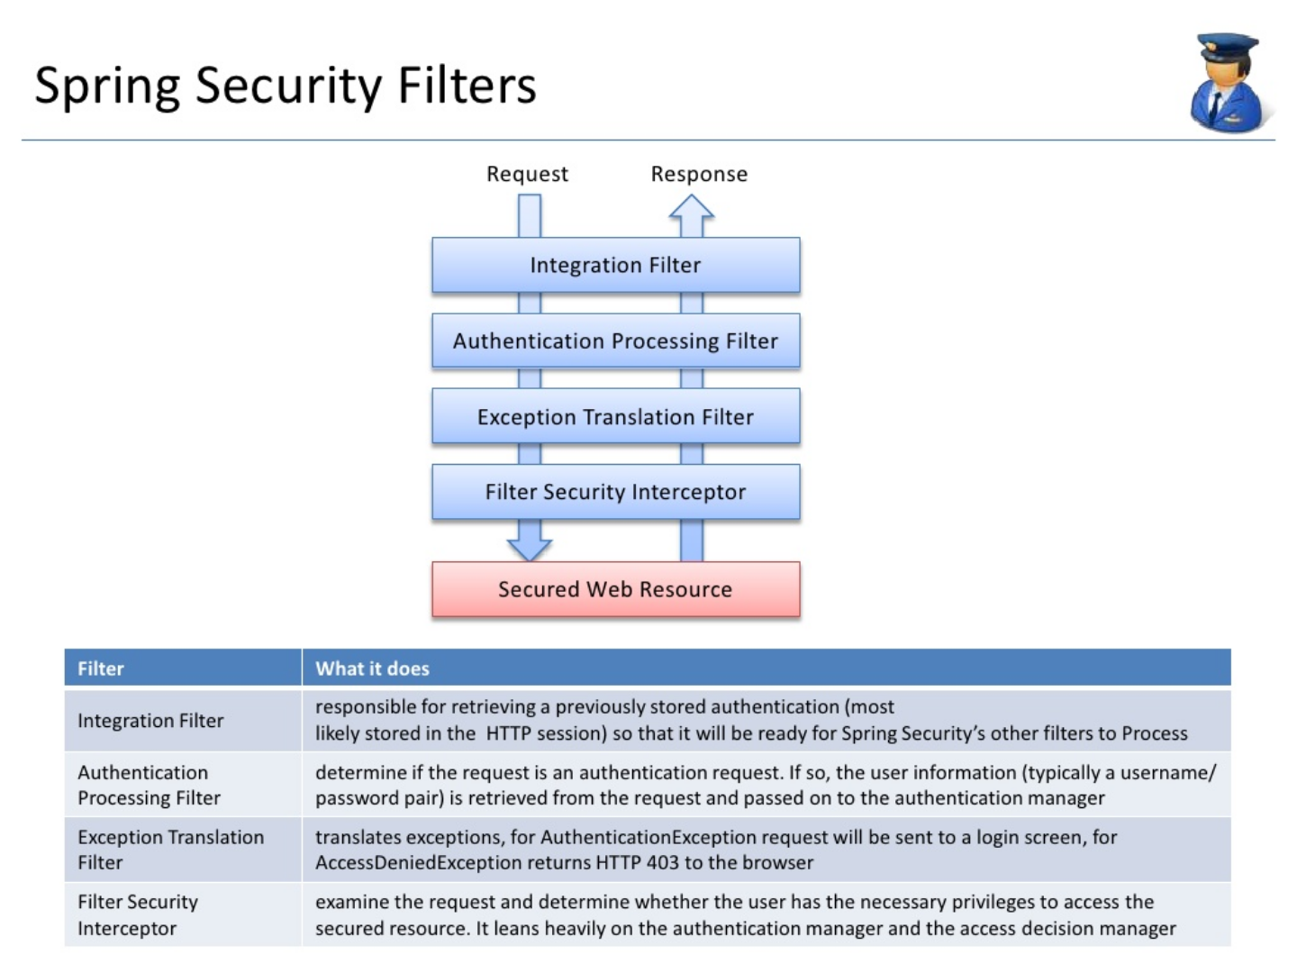

Slide 69
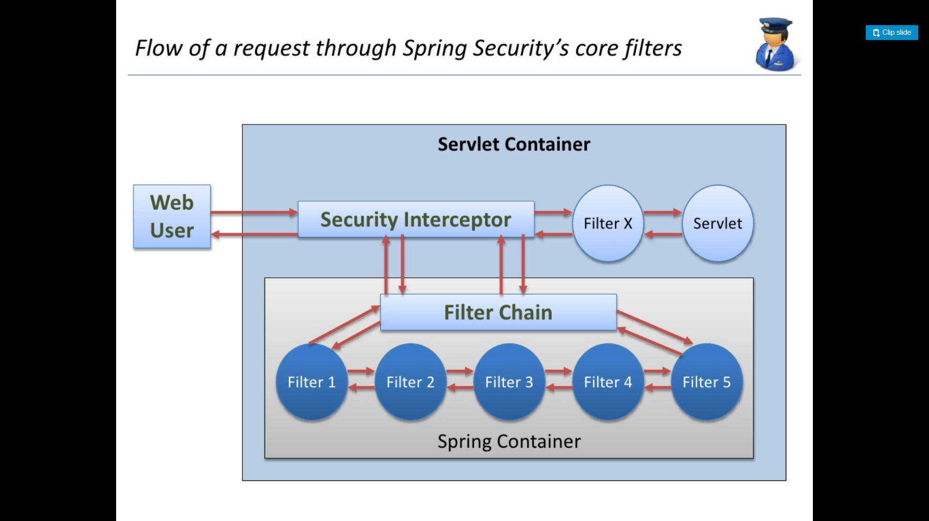

Slide 70
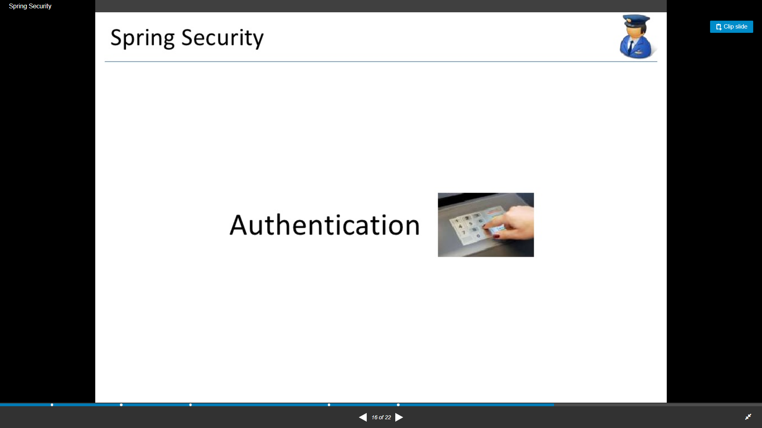

Slide 71
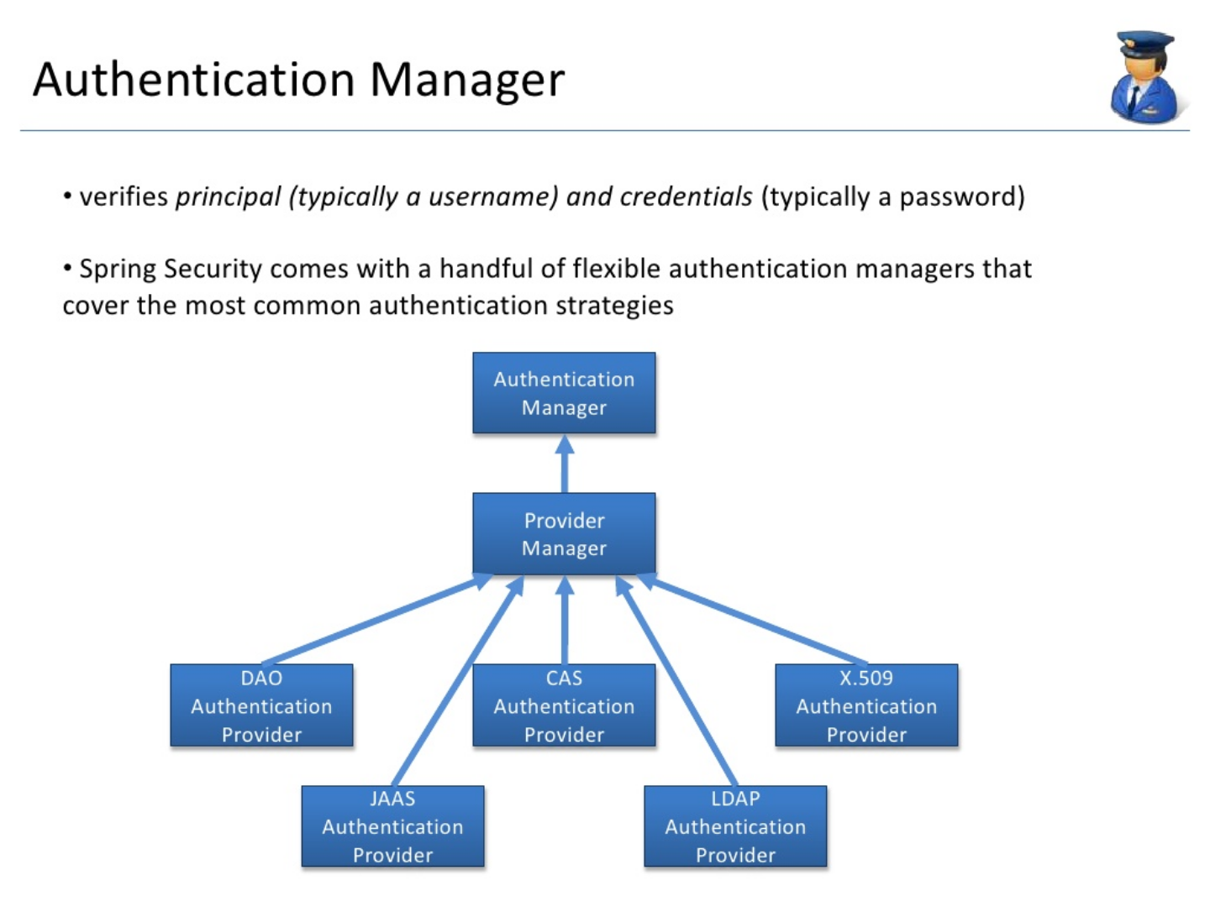

Slide 72
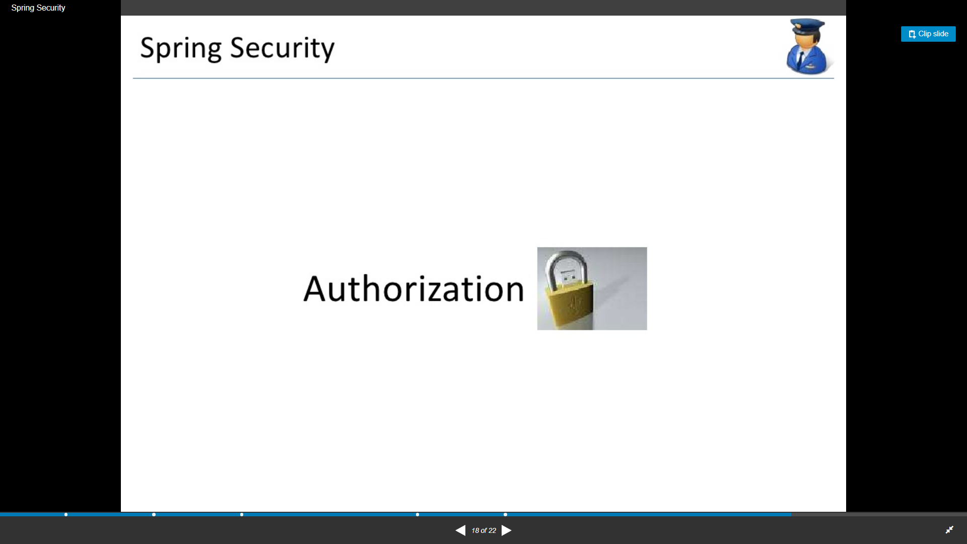

Slide 73
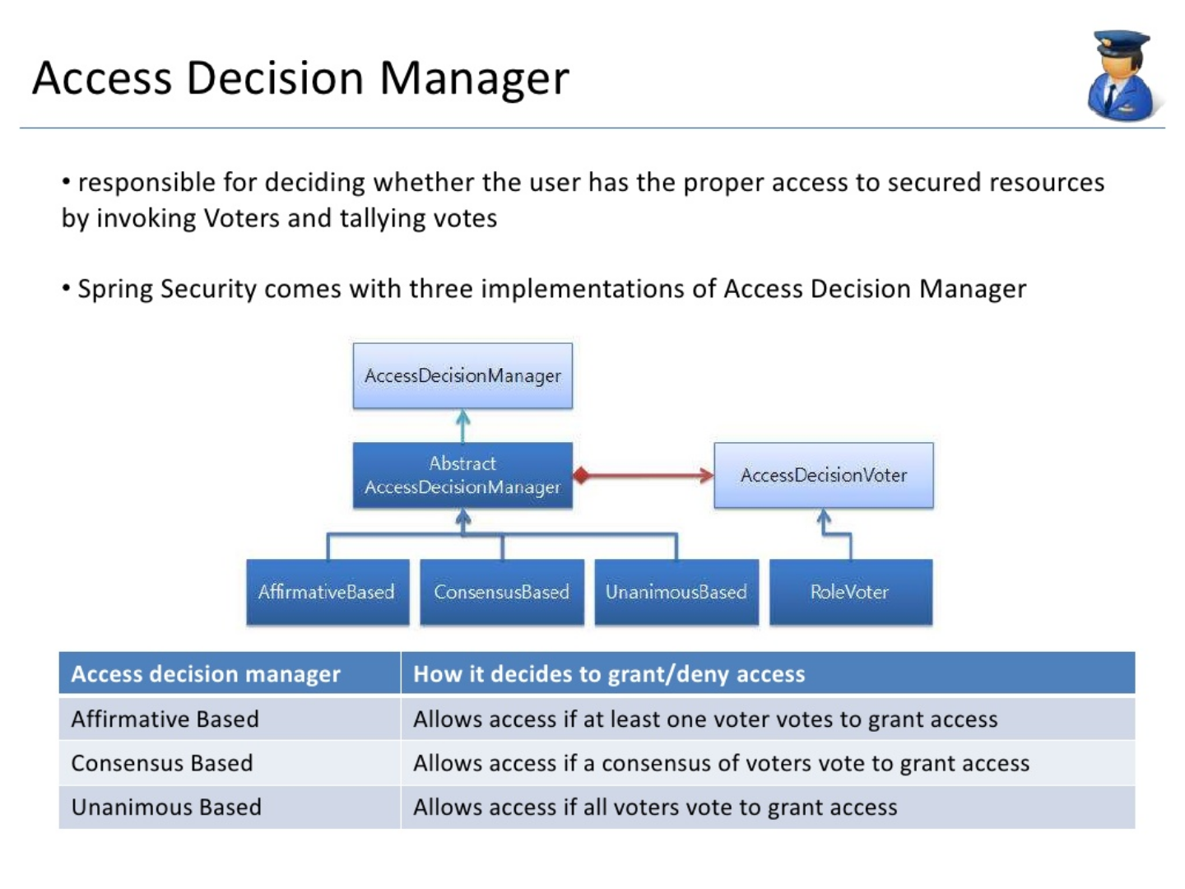

Slide 74
Creating a Keystore File and Keystore Password for HTTPS Connections
% keytool -genkey -alias tomcat -keyalg RSA -keystore /keystore-location -storepass password
keytool -genkey -noprompt -alias <your-alias> -keyalg RSA -keystore <your-file-name> -keypass <your-password>
-storepass <your-password> -dname "CN=<your-cert-name>, OU=<your-organization-unit>, O=<your-organization>,
L=<your-location>, ST=<state>, C=<two-letter-country-code>"

Slide 75
Creating a Keystore File and Keystore Password for HTTPS Connections
keytool -genkey -noprompt -alias tomcat-localhost -keyalg RSA -keystore localhost-rsa.jks -keypass test@123 -storepass test@123 -dname "CN=tomcat-cert, OU=Dev, O=Virtusa, L=Chennai, ST=TN, C=IN"
Enhance the certificate
keytool -importkeystore -srckeystore localhost-rsa.jks -destkeystore banking-rsa.jks -deststoretype pkcs12 -noprompt -alias tomcat-localhost -keyalg RSA -keypass test@123 -storepass test@123 -dname "CN=tomcat-cert, OU=Dev, O=Virtusa, L=Chennai, ST=TN, C=IN"

Slide 76
How to Obtain a Signature for an SSL Certificate
Generate
keytool -certreq -v -alias tomcat -keyalg RSA -keystore /keystore-location
keytool -certreq -v -alias tomcat-localhost -keyalg RSA -keystore banking-rsa.jks
Print certificate
% keytool -printcert -file certificate-reply-file
keytool -v -import -trustcacerts -keystore /keystore-location -file certificate-reply-file -alias tomcat
keytool -v -list -keystore /keystore-location

Slide 77
How to configure Maven Tomcat Plugin to use HTTPS (SSL/TLS)
(1)Creating a Keystore
(2)Configuring tomcat7-maven-plugin to use HTTPS
<plugin>
<groupId>org.apache.tomcat.maven</groupId>
<artifactId>tomcat7-maven-plugin</artifactId>
<version>2.2</version>
<configuration>
<path>/</path>
<httpsPort>8443</httpsPort>
<keystoreFile>C:\my-cert-dir\localhost-rsa.jks</keystoreFile>
<keystorePass>123456</keystorePass>
</configuration>
</plugin>

Slide 78
How to configure Maven Tomcat Plugin to use HTTPS (SSL/TLS)
Test
mvn tomcat7:run-war

Slide 79
Questions

Slide 80
Module Summary
Spring Integration Framework.
Message, Channel and Adapter
Understood the different Component Integration
Understood the Event-Driven Architecture

